Slide 1
PGCP
Lectures 1- 15

Slide 2
What is Indian Knowledge System?
Indian civilization is one of the oldest “surviving” civilizations.
a lot of knowledge has been created in course of time
all this indigenous knowledge is Indian Knowledge
It was being passed on through Gurukula system of education
The continuum was lost with the introduction of western education and western education system during the British Rule (See English Education Act 1835)
Reconnecting with this stream of knowledge, comprehending this knowledge and contemplating over its relevance today is of utmost importance
वेदs (Vedas) were conceived as the core of Indian Knowledge
संस्कृत व्याकरण developed as a tool to protect the interpretability of वेदs Vedas

Slide 3
What is वेद
The word ‘वेद’ is derived from root – विद् (to Knowledge)
The word ‘वेद’ is therefore synonymous to ‘Knowledge’
For a very long time वेदs were handed down through oral tradition
वेदs were not composed later than 1500 BCE
वेदs can be looked at as an ‘Important Message’
The composers of this literature wanted to ensure that this ‘Important Message’ reaches generations to come without any distortions
The techniques they employed have succeeded in surviving the test of time to a great extent

Slide 4
Two techniques employed to preserve the message contained in the वेदs
Two measures taken to ensure that the message contained वेदs reaches generations to come without any distortions –
1. Creation of various methods of oral recitation (प्रकृति-पाठ and विकृति-पाठ)
2. Creation of 6 ancillary disciplines

Slide 5
(1) various methods of oral recitation of the वेदs
In course of thousands of years of transfer of Vedic knowledge through oral tradition, distortions in the original words was highly likely
To counter this issue, the Vedic scholars created a tradition of reciting the Vedic मन्त्रs in several ways
The original text is first recited as it is. This is called as संहिता-पाठ
This is followed by the recitation of पद-पाठ
पद-पाठ involves recitation of each word of the text separately
The text is then recited by pairing two words successively and sequentially as follows – 1-2, 2-3, 3-4, 4-5 and so on.
This is called as क्रमपाठ
संहितापाठ, पदपाठ and क्रमपाठ are three types of प्रकृतिपाठs
This exercise is followed by doing विकृतिपाठ

Slide 6
प्रकृति-पाठ
संहिता-पाठ
पद-पाठ
क्रम-पाठ

Slide 7
The विकृति-पाठs
In विकृति-पाठs the words are recited in different combinations
Following are 8 विकृतिs -
(1) जटा (2) माला (3) शिखा (4) रेखा (5) ध्वज (6) दण्ड (7) रथ (8) घन
Read more about the same on - https://en.wikipedia.org/wiki/Vedic_chant
Watch videos - https://www.youtube.com/@TheGhanapati

Slide 8
विकृति-पाठ
जटा
शिखा
ध्वज
रथ
रेखा
घन
दण्ड
माला

Slide 9
Changing Media From Oral to Digital
Oral transformation of Knowledge
Writing and copying from palm-leaf manuscripts
Printing the exact same content in paper books
Digital medium – easy access, transfer, navigation
Multimedia – Text, Visual, Audio..Heading back to ORAL tradition?

Slide 10
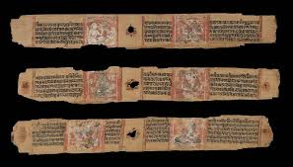
Some Examples
Palm-leaf manuscripts –
Digital Texts - https://ashtadhyayi.com/
https://www.gitasupersite.iitk.ac.in/
https://sanskrit.uohyd.ac.in/scl/e-readers/sankshepa_ramayanam/ramayana-interface/index.html

Slide 11
(2) Creation of 6 Ancillary Disciplines
Second measure taken to ensure that the Vedic message reaches the later generations without any destortions was the creation of 6 Ancillary disciplines or वेदाङ्गs
Following are the वेदाङ्गs –
शिक्षा – It discusses the nuances of pronunciation. Study of शिक्ष enables one to pronounce the Vedic मन्त्रs correctly
कल्प – It discusses the ritualistic and social aspects of the वेदs
व्याकरण - It analyses the languages and helps in aptly interpreting it
छन्दः – It is a study of poetic meters and verses in Sanskrit. This field of study was so important for the composition of वेदs that the वेदs themselves are sometimes referred to as छन्दः
ज्योतिष – It studies ज्योतिः or luminaries visible in the sky. This is important for determining the appropriate timing for performing various rituals
निरुक्त - it is a systematic creation of a glossary. It discusses how to understand archaic, uncommon words in Vedic corpus

Slide 12
वेदाङ्ग
शिक्षा
कल्प
व्याकरण
छन्दः
ज्योतिष
निरुक्त
श्रौतसूत्र
गृह्यसूत्र
शुल्बसूत्र
धर्मसूत्र
Use of Vedic corpus in Rituals
Geometry concerned with constructing यज्ञ-वेदी
Rites of passage – Wedding, birth, naming, coming of age etc
Rules of behavior recognized by community

Slide 13
What is ‘Language’
A system through which beings communicate
Language is not exclusive to human beings
Even animals, birds and insects communicate
Communication may not always through speech. It can happen through writing and even gestures
Perhaps human languages are much more complex. That is why only human beings have news papers, books, libraries, computers and Universities
We acquire such complex languages due to our innate ability to communicate
Just is birds are designed in such a way that they can fly, human beings are designed in such a way that they can communicate in a very complex language
Languages spoken in different parts of the world are given different names like English, Spanish, Gujarati, Hindi, Marathi, Telugu etc.

Slide 14
Indian Outlook Towards ‘Language’
Language is considered Divine in the Vedic culture
10th मण्डल of the ऋग्वेद has a hymn dedicated to वाक्-देवता called as वागाम्भृणी-सूक्त or वाक्-सूक्त dedicated to वाक्-देवता
There are many मन्त्रs in the oldest वेद, i.e., ऋग्वेद which discuss various grammatical categories of languages (for example ऋग्वेद 4.58.3)
Language training constituted the first and the most important part of Vedic education
4 out of 6 वेदाङ्गs are connected to language (namely शिक्षा, व्याकरण, छन्दः and निरुक्त)

Slide 15
Language and Knowledge
Knowledge is abstract
Language is a like a vessel that can contain Knowledge
Knowledge is not only communicated, rather created in a language
Language is required to conceive, encode and retain knowledge
अनुविद्धमिव ज्ञानं सर्वं शब्देन भासते (वाक्यपदीय1.131) Knowledge seems to be pervaded by शब्द
If the vessel is perfected, knowledge can be transferred seamlessly
Therefore there is a huge tradition of language analysis and attempts to understand Language in Indian Tadaition

Slide 16
Concept of भाषा
It is well known that Panini’s Grammar is a Grammar of Sanskrit, however this fact is mentioned nowhere in any of the foundational works of Paninian Grammar
The word Sanskrit is used mostly as an adjective of भाषा
On having a closer look at the languages one realizes that differentiating one language from another is a tricky task
Therefore भाषा is understood as one whole system which enables communication
It is understood as a dynamic concept which is continuously changing with space and time
Therefore the word भाषा occurs many times in Panini’s Grammar

Slide 17
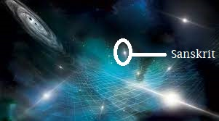
What is Sanskrit

Slide 18
…
Something that is described exhaustively is Sanskrit
So व्याकरण is of भाषा
भाषा becomes संस्कृत because of व्याकरण
Grammar is not of Sanskrit, Rather a Language becomes Sanskrit because of Grammar

Slide 19
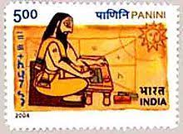
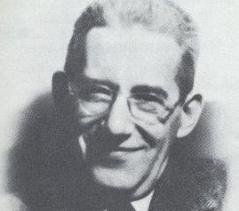
Exhaustive to what Extent
“one of the greatest monuments of human intelligence... No other language, to this day, has been so perfectly described.” (Language, 1933, p.11)
Leonard Bloomfield (1887-1949), an eminent American Linguist

Slide 20
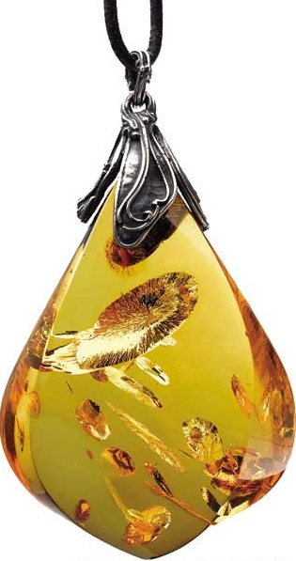
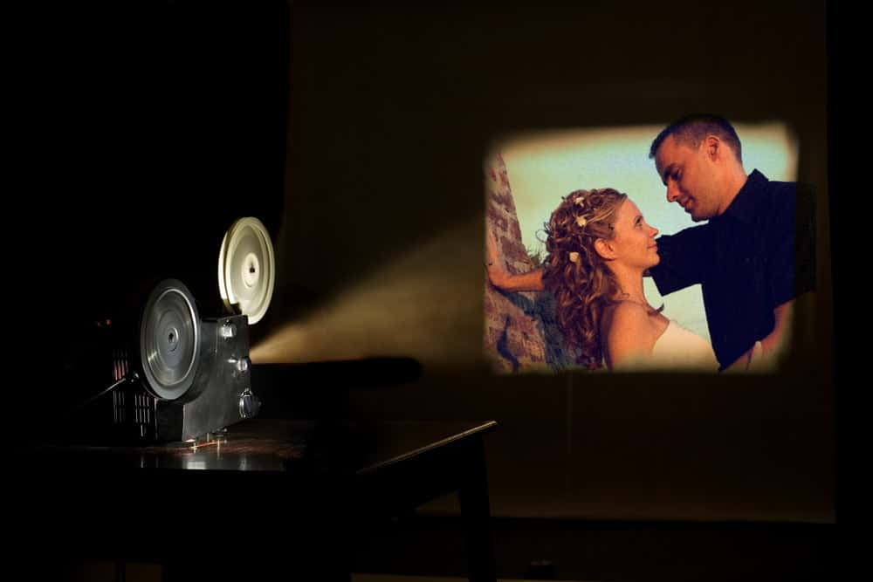
Need for Exhaustive Description
It is thus able to create a snapshot of the exact state of language (भाषा) at that point in space and time
https://www.youtube.com/watch?v=a3ZuyZIwa3o

Slide 21
How does that help?
In two ways –
Facilitating the interpretability of the literature composed in that language
That is why व्याकरण is counted among the 6 वेदाङ्गs
In fact the most important one of them all –
छन्दः पादौ तु वेदस्य हस्तौ कल्पोऽथ पठ्यते। ज्योतिषामयनं चक्षु निरुक्तं श्रोत्रमुच्यते॥ शिक्षा घ्राणं तु वेदस्य मुखं व्याकरणं श्रुतम्। तस्मात् साङ्गसधीत्य हि ब्रह्मलोके महीयते॥
Availing an option of such a language to the later scholars whose interpretability will remain intact for a very long time, (if written in that fixed framework of rules.)
That is why not only Vedic scholars, but even Janina and Buddhist scholars eventually chose Sanskrit to write their technical works
Poets like Kalidasa became immortal
Sanskrit remained as a preferred language for writing all eternal literature and all scientific literature – Physics, mathematics, statecraft, agriculture etc.

Slide 22
व्याकरण and Grammar
The Traditional Western idea of Grammar comprises of a collection of prescriptive rules for effectively communicating in a language
These rules were looked at as PRESCRIPTIVE or governing the natural instincts of language users
The word ‘Grammar’ is the closest possible translation of the word ‘व्याकरण’
However the background and objectives of व्याकरण are much different
It developed as the most important among the 6 disciplines ancillary to the study of वेदs
Therefore facilitating the undistorted transmission of the ‘Important Message’ of the वेदs is it’s primary objective
व्याकरण attempts to do so by offering an exhaustive DESCRIPTION of भाषा
भाषा/वाणी/वाक् is like a container of knowledge/वेद

Slide 23
What is व्याकरण?
The objective of व्याकरण is to distinguish between correct usage from not so correct usage of sentences and words, i.e., to distinguish between साधु शब्द and असाधु शब्द
It is a set of rules that offers a detailed description of a language
Traces of initial attempts to do व्याकरण can be found in the Vedic texts
The पदपाठ of Vedic मन्त्रs by Shakalya is also a sort of व्याकरण
In the पदपाठ, the grammarian Shakalya has shown the segmentation of words in the मन्त्रs
The word ‘व्याकरण’ is derived from वि+आ+कृ and it literally means ‘cutting’.
In व्याकरण we try to cut the sentences into words and words into further meaningful units.

Slide 24
The method of व्याकरण
व्याकरण attempts to distinguish between साधु शब्द and असाधु शब्द
The महाभाष्य of महर्षि पतंजलि discusses the exact way in which व्याकरण does this.
It discusses the various possibilities in which this can be done -
giving an exhaustive list of both साधु शब्दs as well असाधु शब्दs and then prescribing the use only of साधु शब्दs
giving an exhaustive list only of असाधु शब्दs and saying that all the remaining शब्दs are साधु शब्दs
giving an exhaustive list only of साधु शब्दs and prescribing the use only of these शब्दs

Slide 25
It is well known that for each साधु शब्द there are many असाधु शब्दs, so giving an exhaustive list of साधु शब्दs only is the shortest way to achieve the goal, but then even the list of साधु शब्दs is very long. So it is very difficult to make study and retain the entire list of साधु शब्दs. That is why creating a प्रतिपद-पाठ also becomes a lengthy process
The grammarians hence, have come up with a set of default rules or उत्सर्ग and exceptions or अपवाद

Slide 26
लक्ष्य and लक्षण
The word लक्ष्य is used for the target, which is ‘correct words’ and
the word लक्षण is used for the rules of grammar that lead us to the लक्ष्य
the grammarians had the लक्ष्य in front of them when they framed the rules or लक्षणs of grammar
However, with the passage of time any language undergoes change, and the लक्ष्य goes on becoming more and more vague
So, for us, the students of Sanskrit Grammar, it is primarily the लक्षण, which help us understand the लक्ष्य.

Slide 27
वि-आ-कृ – Breaking up into smaller parts
Breaking up discourse into sentences
Breaking sentences into words
Breaking up words into further meaningful units –
Words
Roots
Suffixes
Verbal Roots/धातु
Nominal Base/प्रातिपदिक

Slide 28
Tradition of व्याकरण
Scholars believe that व्याकरण-शास्त्र had already attained completeness before the available Vedic पदपाठs
In tradition it is believed that lord ब्रह्मा first preached this science of words to बृहस्पति.. बृहस्पति taught it to भरद्वाज...and from there it spread in the mortal world
पाणिनि cites 10 of his predecessors in his work अष्टाध्यायी (there may have been many more)
Scholars believe that पाणिनिs व्याकरण is based on a much bigger grammatical system of his predecessor named आपिशलि
Today none of the grammars written prior to पाणिनि are available to us in entirety

Slide 29
Who is Panini
Panini was a Grammarian or a वैयाकरण who has written the grammar of Sanskrit language
The grammar that he has written is known as अष्टाध्यायी, since there are 8 chapters or अध्यायs in his book
From some references it seems that he belonged to शलातुर village located somewhere in the present north-west Pakistan
His mother’s name may be दाक्षि and father’s name may be पणिन्
There are various opinions about the period of his existence. As per the most accepted one, Pāṇini lived between 600 BCE to 500 BCE.

Slide 30
5 books of Paninian System of Grammar (or पाणिनीय व्याकरण तन्त्र)
अष्टाध्यायी-सूत्रपाठ
धातुपाठ
गणपाठ
उणादिसूत्रपाठ
लिङ्गानुशासन

Slide 31
The अष्टाध्यायी-सूत्रपाठ
There are 8 chapters (i.e., अध्यायs) in this book. That is why it is called as अष्टाध्यायी
Each chapter is divided into 4 sub-chapters (i.e., पादs)
In each of these पादs there are varying number of aphorisms (i.e., सूत्रs)
These सूत्रs are the rules that lead us to correct usages with the inputs from the धातुपाठ and the गणपाठ
The सूत्रपाठ or अष्टाध्यायी-सूत्रपाठ is the central text of पाणिनीय व्याकरण तन्त्र while 4 others are subsidiary to it.

Slide 32
The धातुपाठ
The धातुपाठ is almost an exhaustive collection of all the verbal roots (i.e., धातुs) that are used in Sanskrit language
The currently available version of the धातुपाठ also provides the most prevalent meanings of each of these धातुs
The rule - भूवादयो धातवः (1.3.1) in the अष्टाध्यायीसूत्रपाठ assigns the name धातु to all the words enlisted in the धातुपाठ
The धातुs in the धातुपाठ are further divided into 10 classes

Slide 33
The गणपाठ
The गणपाठ is a collection of various nominal root words (also called as प्रातिपदिकs) that are to be treated uniformly according to certain rules of the अष्टाध्यायीसूत्रपाठ
There are numerous rules in the अष्टाध्यायीसूत्रपाठ where one can find the word ‘आदि’ for example –
सर्वादीनि सर्वनामानि (१.१.२७) [सर्व-आदीनि सर्वनामानि]
स्वरादिनिपातमव्ययम् (१.१.३७) [स्वर्-आदि-निपातम् अव्ययम्]
चादयोऽसत्त्वे (१.४.५७) [च-आदयः असत्त्वे]
प्रादयः (१.४.५८) [प्र-आदयः] etc.
The word ‘सर्वादिनि’ means – सर्वः आदौ येषां तानि [those (words) of which सर्व is in the beginning]
One has to refer to the गणपाठ in order to find out the list of those words whose first member is the word सर्व
Once the गणपाठ provides the list of all those words, the सूत्रपाठ terms all of them as सर्वनाम
It then uses this term ‘सर्वनाम’ to describe the derivational processes that only the words in this group undergo

Slide 34
The उणादिसूत्रपाठ
This is another list of सूत्रs quite similar to the अष्टाध्यायीसूत्रपाठ, however the scope of application of the सूत्रs in the उणादिसूत्रपाठ is generally much lesser than that of सूत्रs of the अष्टाध्यायी
It is divided into 5 chapters containing around 750 सूत्रs in all
Each सूत्र in the उणादिसूत्रपाठ generally mentions a small list of धातुs and a suffix that can be applied to only the members of that small set of धातुs to derive small set of words
Some scholars opine that this book was written by शान्तनव
Irrespective of who the author of this work may be, उणादिसूत्रपाठ is an indispensable part of पाणिनीय व्याकरण तन्त्र

Slide 35
The लिङ्गानुशासन
This book contains around 190 सूत्रs divided into 4 अधिकारs namely –
स्त्रीलिङ्गाधिकार
पुंलिङ्गाधिकार
नपुंसकलिङ्गाधिकार
स्त्री-पुंसाधिकार and
पुं-नपुंसकाधिकार
Once we reach up to a nominal stem through the combination of a root and a suffix, it’s gender has to be determined
लिङ्गानुशासन aids in determining the gender of a word
Most of the words are in one of the three genders namely – masculine, feminine and neuter
There are some words that can be used in either feminine or masculine gender
A few words can be used in either masculine or neuter gender
There are a few words that can be used in any of the three genders

Slide 36
The वार्त्तिकs
पाणिनिis not a sole contributor to what we know today as पाणिनीयव्याकरणतन्त्र
पाणिनीयव्याकरणतन्त्र is also called as त्रि-मुनिव्याकरण as three sages, namely –
पाणिनि
कात्यायनand
पतंजलि have contributed to it.
The वार्त्तिकs are believed to have been written by sage कात्यायन
It is not a separate work in Sanskrit Grammar
वार्त्तिकs are one-line comments made on some सूत्रs of पाणिनि
They are always studied along with the related सूत्र
Some of them elucidate the related सूत्र while some others propose amendments in the rules

Slide 37
The महाभाष्य
‘भाष्य’ means a ‘long commentary’
This is an extensive commentary over selected सूत्रs and वार्त्तिकs
It encompasses almost all the aspects of a सूत्रor वार्त्तिक it takes up for discussion
Similar भष्यs are also available on other दर्शनs like योग, वेदान्तand मीमांसा
However the भाष्यon Sanskrit व्याकरणis the oldest, most extensive and most authentic, that is why it is called as महा-भाष्य
Sage पतंजलिis the author of theमहाभाष्य
While commenting upon the सूत्रs and the वार्त्तिकs, sage पतंजलिhas added many new insights of his own, making the महाभाष्यthe most authentic book in पाणिनीयव्याकरणतन्त्र

Slide 38
Other important works in Paninian Grammatical System
Book | Author | Topic | Date
वाक्यपदीय | भर्तृहरि | Seminal work on Philosophy of Language | 400 CE
काशिका | वामन, जयादित्य | Oldest completely available commentary on the अष्टाध्यायी | 700 CE
महाभाष्यप्रदीप | कैयट | Oldest completely available commentary on the महाभाष्य | 1000 CE
सिद्धान्त-कौमुदी | भट्टोजि दीक्षित | The most widely read commentary on the अष्टाध्यायी | 1550 – 1600 CE
लघु-सिद्धान्त-कौमुदी | वरदराज | Abridged version on the सिद्धान्त-कौमुदी | 1700 CE
वैयाकरण-भूषणम् | कौण्ड भट्ट | Exploration of philosophical aspects of Language | 1600 - 1650 CE
परिभाषेन्दु-शेखर | नागेश भट्ट | Most important work on the rules for interpretation of the सूत्रs | 1750 – 1800 CE

Slide 39
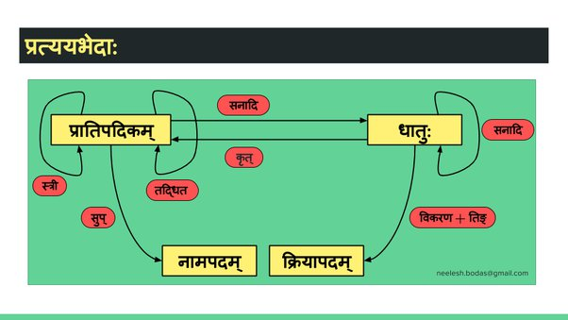
Interplay of प्रकृति and प्रत्यय

Slide 40
Contents of the अष्टाध्यायी
From the kind of language that पाणिनि employs for writing the अष्टाध्यायीit is quite obvious that teaching the grammar of Sanskrit is not his objective
He has just attempted to give an exhaustive description of Sanskrit language with words as minimum as possible
He, therefore, is more interested in saving words that are available through अनुवृत्ति from the previous सूत्र rather than grouping the rules according to the subtopic of व्याकरण that they are related to

Slide 41
…
Based on its contents however, the अष्टाध्यायीcan still be broadly divided into two parts
Part – 1 – covering various roots and suffixes – described in chapters 1 to 5
Here, we find a description of two types of roots – namely 1. Verbal roots and 2. Nominal roots
Of the suffixes that are described her, there are - 1.suffixes that can be added to verbal roots, 2. Suffixes that can be added to nominal roots and 3. Suffixes that convert verbal roots or nominal roots into new verbal roots
Rules related to compounding of words and those related to syntax are also found in chapters 1 and 2 of the अष्टाध्यायी
Part – 2 – covering various processes that roots and suffixes undergo when they combine together – described in chapters 6 to 8
Here we find rules related to various processes like replacement of sounds, addition, elision and reduplication.

